Slide 1
Review on SeismoGen
2022. 10. 19.
Keunsuk Cho @aiml-k

Slide 2
Outline
SeismoGen
  Resource available
  Dataset
  Model architcture
  Training procedure
  Evaluation
Versus TimeGAN
  Datasets and assumptions
  Base-model : convolutional vs recurrent
    In terms of modeling time-series..
  What it generates : global vs local

Slide 3
SeismoGen

Slide 4
Resource available
Found a gitlab
  Only generated data are available
  No codebase here
Also found a github, but seems irrelevant
Should ask the author, or the sanity check for the model is not available

Slide 5
Dataset - Construction
Source of data
  3 stations near Oklahoma city
  1025/1120/767 events(earthquakes) recorded
Positive/negative sample
  Each sample is of length 1600(40sec x 40hz) npts
  Positive if seismic event is included in the sample
Additional Augmentation
  Depending on the size of dataset

Slide 6

Dataset – Basic statistics
Statistics of the data
  Recorded at local distance
    $R<200 km$
  Consists mainly of earthquakes of small magnitudes
    $M_{L}<3$

Slide 7
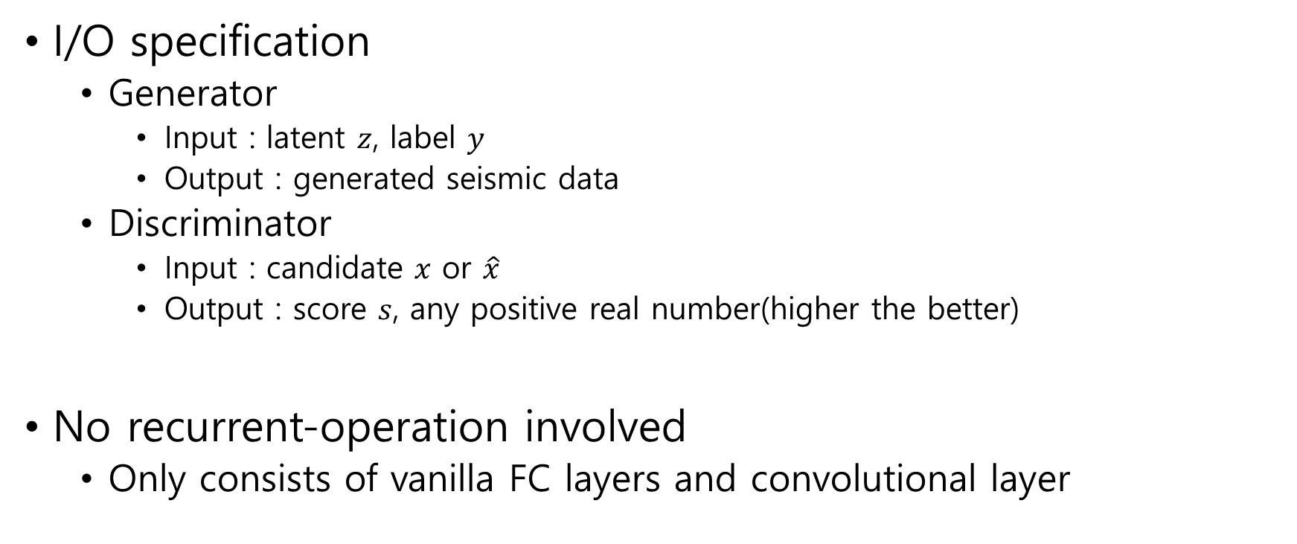
Model architecture – in general
I/O specification
  Generator
    Input : latent $z$, label $y$
    Output : generated seismic data
  Discriminator
    Input : candidate $x$ or $\hat{x}$
    Output : score $s$, any positive real number(higher the better)
No recurrent-operation involved
  Only consists of vanilla FC layers and convolutional layer

Slide 8
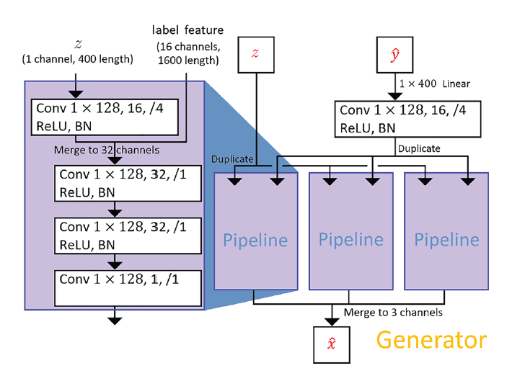
Model architecture - generator

Slide 9
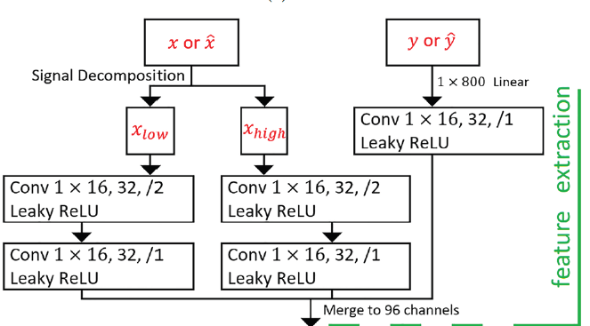
Model architecture - discriminator

Slide 10
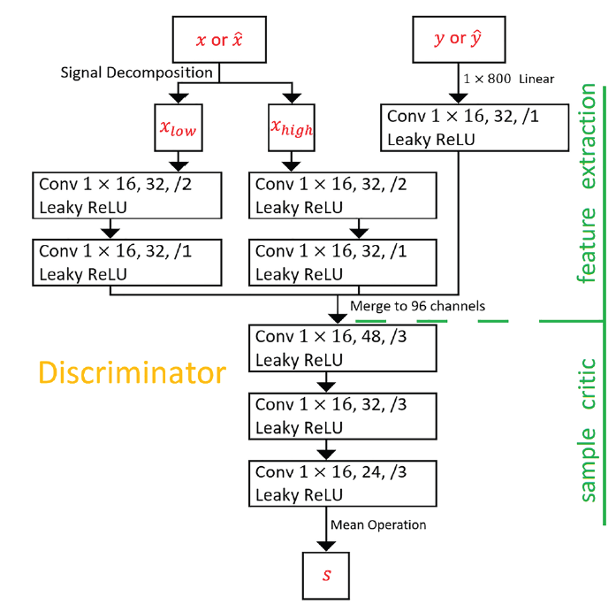
Model architecture - discriminator

Slide 11
Model architecture – hparam
T
Kernel size

Slide 12
Training Procedure

Slide 13
Versus TimeGAN

Slide 14
What it’s solving
Target task : learn the earthquake-signal
  With restricted condition
    Near distance from source / small magnitude
What model can do :
  Outputs a long-lengthed earthquake
    TimeGAN : learns a local-dynamics with specified seq_len
    seismoGen : outputs 1600-npts of generated eq-signal

Slide 15
Model architecture
Rnn-based vs cnn-based
Embedding included vs no
forcing of learning the conditional prob
Feature extraction

